Slide 1
Men’s Health @York

Slide 2
Session Agenda
Welcome
Tonight’s Topic - Mental Health during Covid
Some Stats
Some useful mental health models
What to do about it
Next meeting

Slide 3
Men’s Health@York
The Aim
To provide a forum to enable men to share in common activities and build relationships that enable them to talk more openly about their issues, thereby increasing their overall health.
Men, talking openly while doing activities, together

Slide 4
How it works
Series of facilitated events including talks relating to men’s health
Ongoing common interest group meeting up regularly to participate in activities,...and talk
Ongoing common interest group meeting up regularly to participate in activities,...and talk
Ongoing common interest group meeting up regularly to participate in activities,...and talk
Ongoing common interest group meeting up regularly to participate in activities,...and talk

Slide 5
Why is it important to talk about mental health?
30% of the UK workforce has been formally diagnosed with a MH condition at some point in their lifetime
2 in 5 employees report experiencing poor mental health symptoms related to work in the last year
A predicted but unknown impact on mental health caused by the pandemic
In the UK, 36% reported that work pressure had increased, 43% said that they did not have time to get their work done and 42% reported more fatigue than before ‘lockdown’

Slide 6
Some Research Findings
Based on first 6 weeks of lockdown
3077 adults in UK
Sampled in 3 waves - 1-3 weeks between each wave
Findings
Suicide ideation increased over time
Symptoms of anxiety, levels of defeat & entrapment decreased
Levels of depressive symptoms and loneliness remained unaltered
Those with pre-existing mental health symptoms have worse mental health outcomes
Separate Study - Over three-quarters (79%) of people with pre-existing mental illness said that their mental health had got ‘worse’ or ‘much worse’ as a result of the pandemic
Notes:
Mental health and wellbeing during the COVID-19 pandemic: longitudinal analyses of
adults in the UK COVID-19 Mental Health & Wellbeing study

Slide 7
Mental & Physical Health
Long term physical illness
Physically symptom
free
Physical Health
Awareness of or a diagnosed psychological disorder
Full psychological wellbeing
Mental Health

Slide 8
Mental health continuum
Maximum Mental Wellbeing
A person with a serious mental health diagnosis but who copes well and has positive mental health
A person with no mental illness or disorder and positive mental health
Severe Diagnosis
No Diagnosis
A person with a diagnosis of a serious mental illness and who has poor mental health
A person with no diagnosed mental illness or disorder but who has poor mental health
Adapted from Tudor,K, 1996: Mental Health Promotion, Paradigms and Practice
Minimum Mental Wellbeing
Notes:
Refer to the exercise powerpoint -
https://docs.google.com/spreadsheets/d/12JN6GZjj6a_43ul_XOGpD0dIH___UXe9QsTGXiDfNRw/edit#gid=0

Slide 9
A sense making model
Remedial Options
Specific Actions
Causal Factor
How a person’s feeling
Remedial Options
Specific Actions
Causal Factor
Remedial Options
Causal Factor
Specific Actions
Remedial Options
Specific Actions
Causal Factor
Remedial Options
Specific Actions

Slide 10
Notes:
Thinking about the remedial actions - the research points to these 5 things being contributory to good mental health so useful to chat through with each other.
Managing our own wellbeing - the five ways to wellbeing see notes at https://www.nhs.uk/conditions/stress-anxiety-depression/improve-mental-wellbeing/
Connect with other people
Be physically active
Learn new skills
Give to others
Pay attention to the present moment (mindfulness)

Slide 11
How are UK Adults managing their mental health
More than eight in ten (82 per cent) of UK adults have experienced stress because of the pandemic
Six in ten (59 per cent) of UK adults who had experienced stress because of the pandemic said walking helped them cope
Half (50 per cent) of UK adults who had experienced stress because of the pandemic said visiting green spaces, such as parks, helped them cope
Almost half (47 per cent) of UK adults who had experienced stress because of the pandemic said contacting family (eg by phone, video chat, etc) had helped them cope
Almost half (46 per cent) of UK adults who had experienced stress because of the pandemic said contacting friends (eg by phone, video chat, etc) had helped them cope
Notes:
New research from the Mental Health Foundation and collaborating universities reveals how UK adults are managing stress during the pandemic

Slide 12
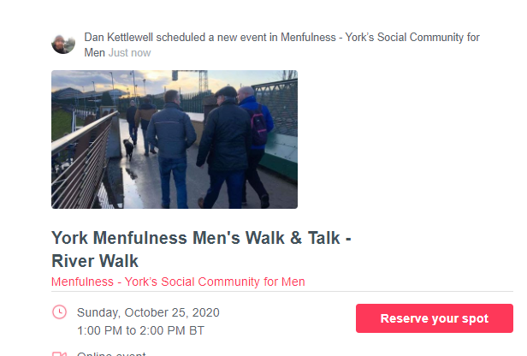
Next Discussion Session
Wednesday 27th January Topic - Stress & Anxiety

